Slide 1
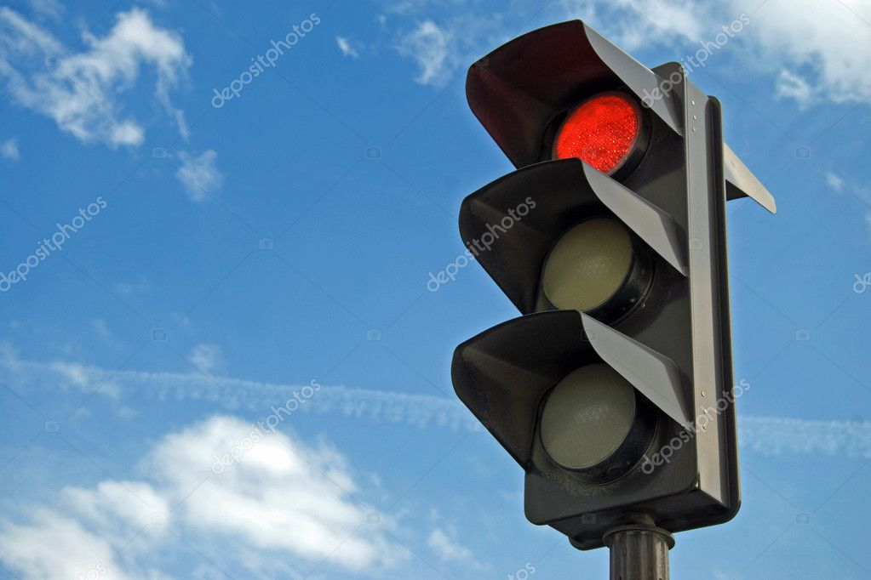
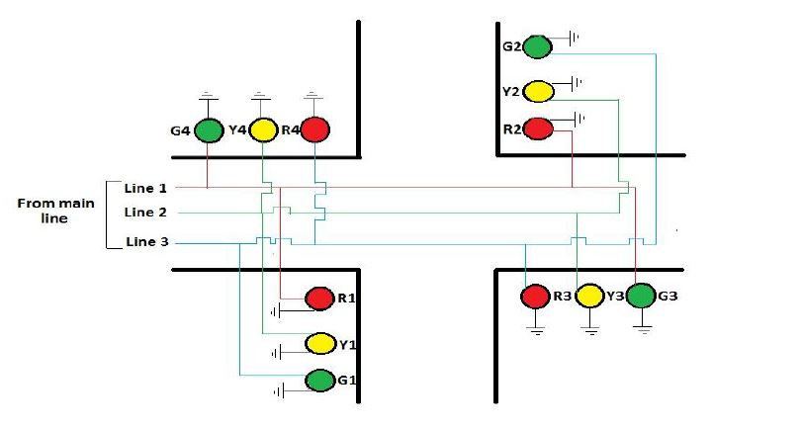
Working
The main power is stepped down by transformer to deliver a secondary output of 9v, 300 mA.
The transformer out put is rectified by a full-wave bridge rectifier comprising diodes D1 through D4. Then regulated by voltage regulator IC1 7805.
IC2 is wired as a multivibrator with ON and OFF periods of 35 and 30 seconds.
When main power is switched on, then pin of IC2 goes high for 35 seconds.

Slide 2
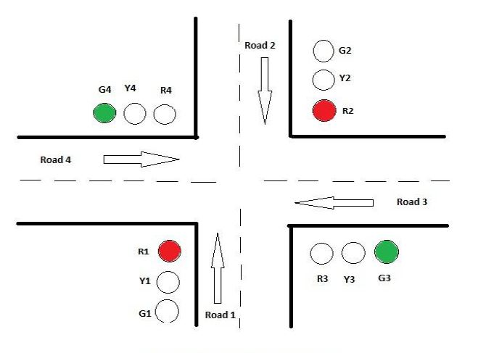
Working
Then relay RL1 energies through transistor T1 and the red lamp R1, R2 glows for stopping Road1 and Road2’s vehicle.
At the same time green lamp G3, G4 glows to run Road3 and Road4’s vehicle for 35 seconds.
The main power is disconnected from the pole of relay RL2.
Then pin of IC3 will remain high and relay RL2 energies through driver transistor T2.
The yellow lamps Y1,Y2,Y3 and Y4 lights up for 5 seconds.

Slide 3
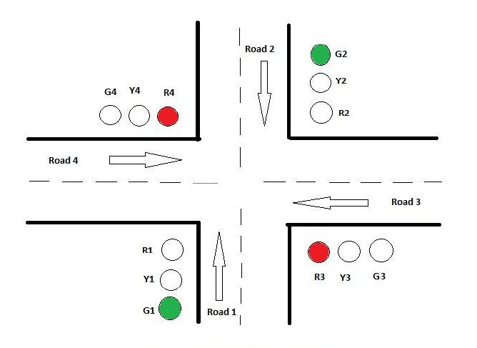
Working
As soon as 5 second time period of timer IC3 at pin 3 lapses, relay RL2 de-energies.
Finally the red lamp R3, R4 glows for stopping Road3 and Road4 vehicles.
At the same time green lamp G1,G2 glows to running Road1 and Road2 vehicles for 30 seconds.

